Slide 1



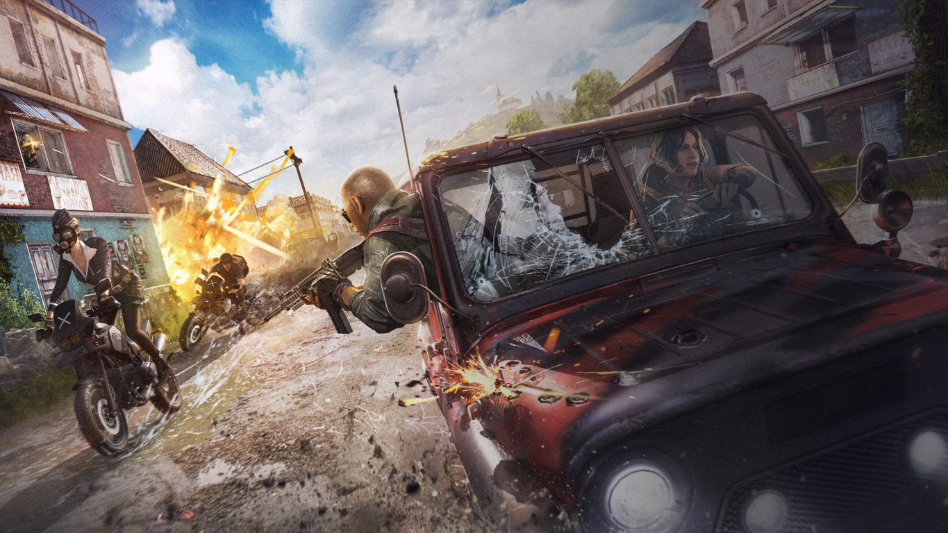
NEWS COMMUNITY MERCHANDISE SEASON 4 ESPORTS LOGIN
BUY NOW
SEASON 4
Experience the battlegrounds like never before
LEARN MORE

Slide 2

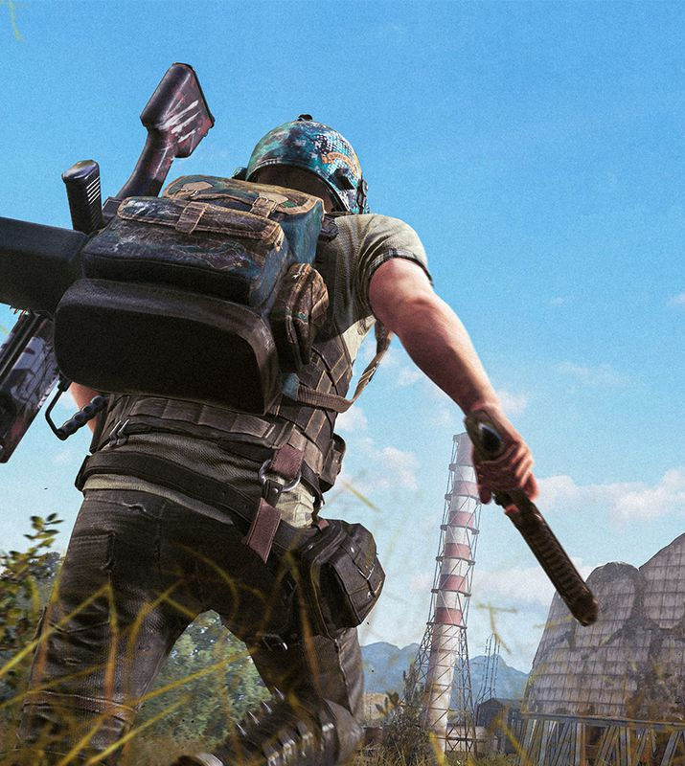
PUBG NATIONS
CUP
PATCH NOTES
New Erangel, Cooperative Mission System,
and Vehicle Balance
Watch the best players in the world battle for glory beginning 8/9.
READ NOW
LEARN MORE

Slide 3

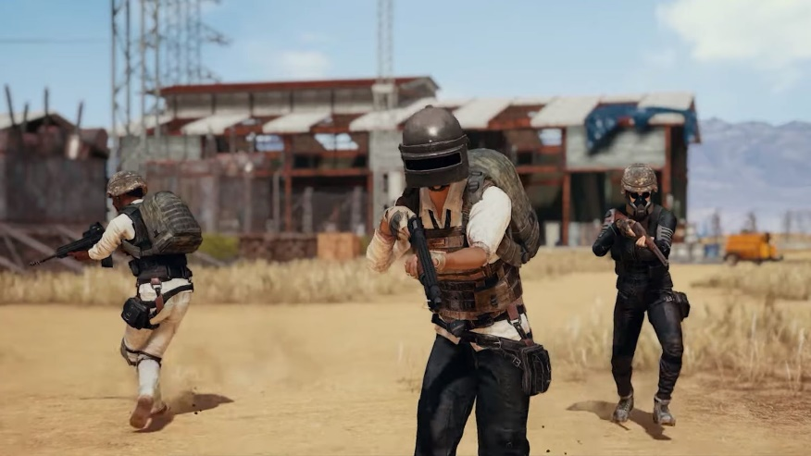
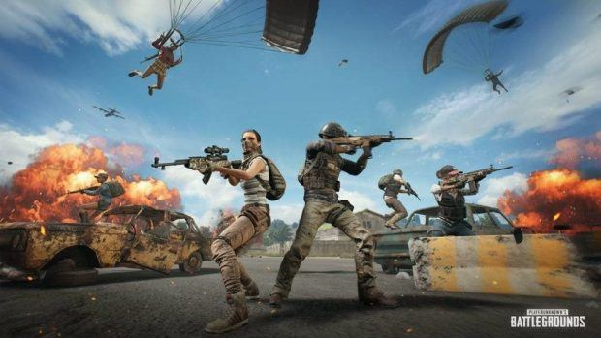
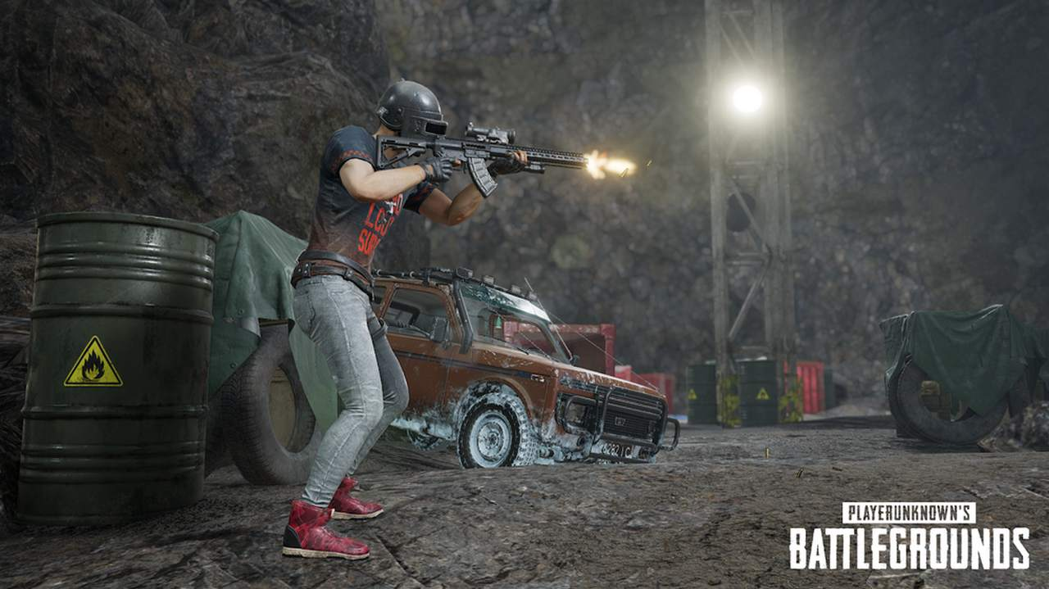
PATCH NOTES
PC
PS4
XBOX
PC UPDATE 4.1 PATCH NOTES
PS4- UPDATE #5 PATCH NOTES
XBOX – UPDATE #8 PATCH NOTES
Hello players! Welcome to PUBG SEASON 4! Quick note before we start! As we take a glimpse into Erangle’s past, it’s the perfect time to talk about the future of..
Hello everyone, Prepare for Update #5, coming to live servers on June 27! This updates features our new progression system called Weapon Mastery, Controller Preset Type C, the new Auto equip..
Hello everyone, Prepare for Update #5, coming to live servers on June 27! This updates features our new progression system called Weapon Mastery, Controller Preset Type C, the new Auto..
READ MORE
READ MORE
READ MORE

Slide 4
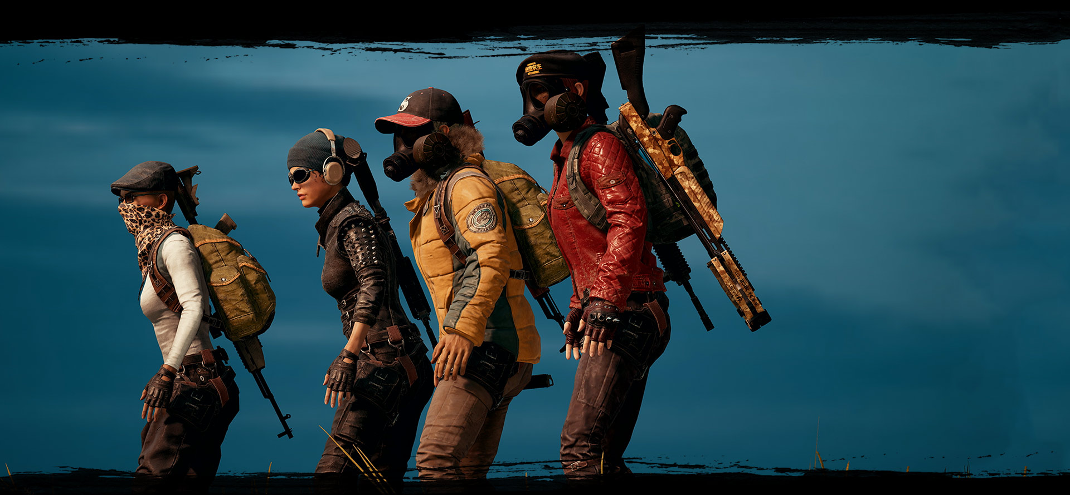












PLAY TODAY ON XBOX, PC, AND PS4
Complete with 100 players on a remote island for a winner-takes all showdown
where strategic gameplay is as important as shooting skills
PARTNERS
COPYRIGHT ©2019 PUBG CORPORATION. ALL RIGHTS RESERVED. PLAYERUNKNOWN’S BATTLEGROUNDS and PUBG are registered trademarks, trademarks or service marks of PUBG CORPORATION.
Partnership Inquiry: Ask_PUBG@bluehole.net
Privacy Policy
Terms of Service
Rules of Conduct
EULA
Player-created Content

Slide 5
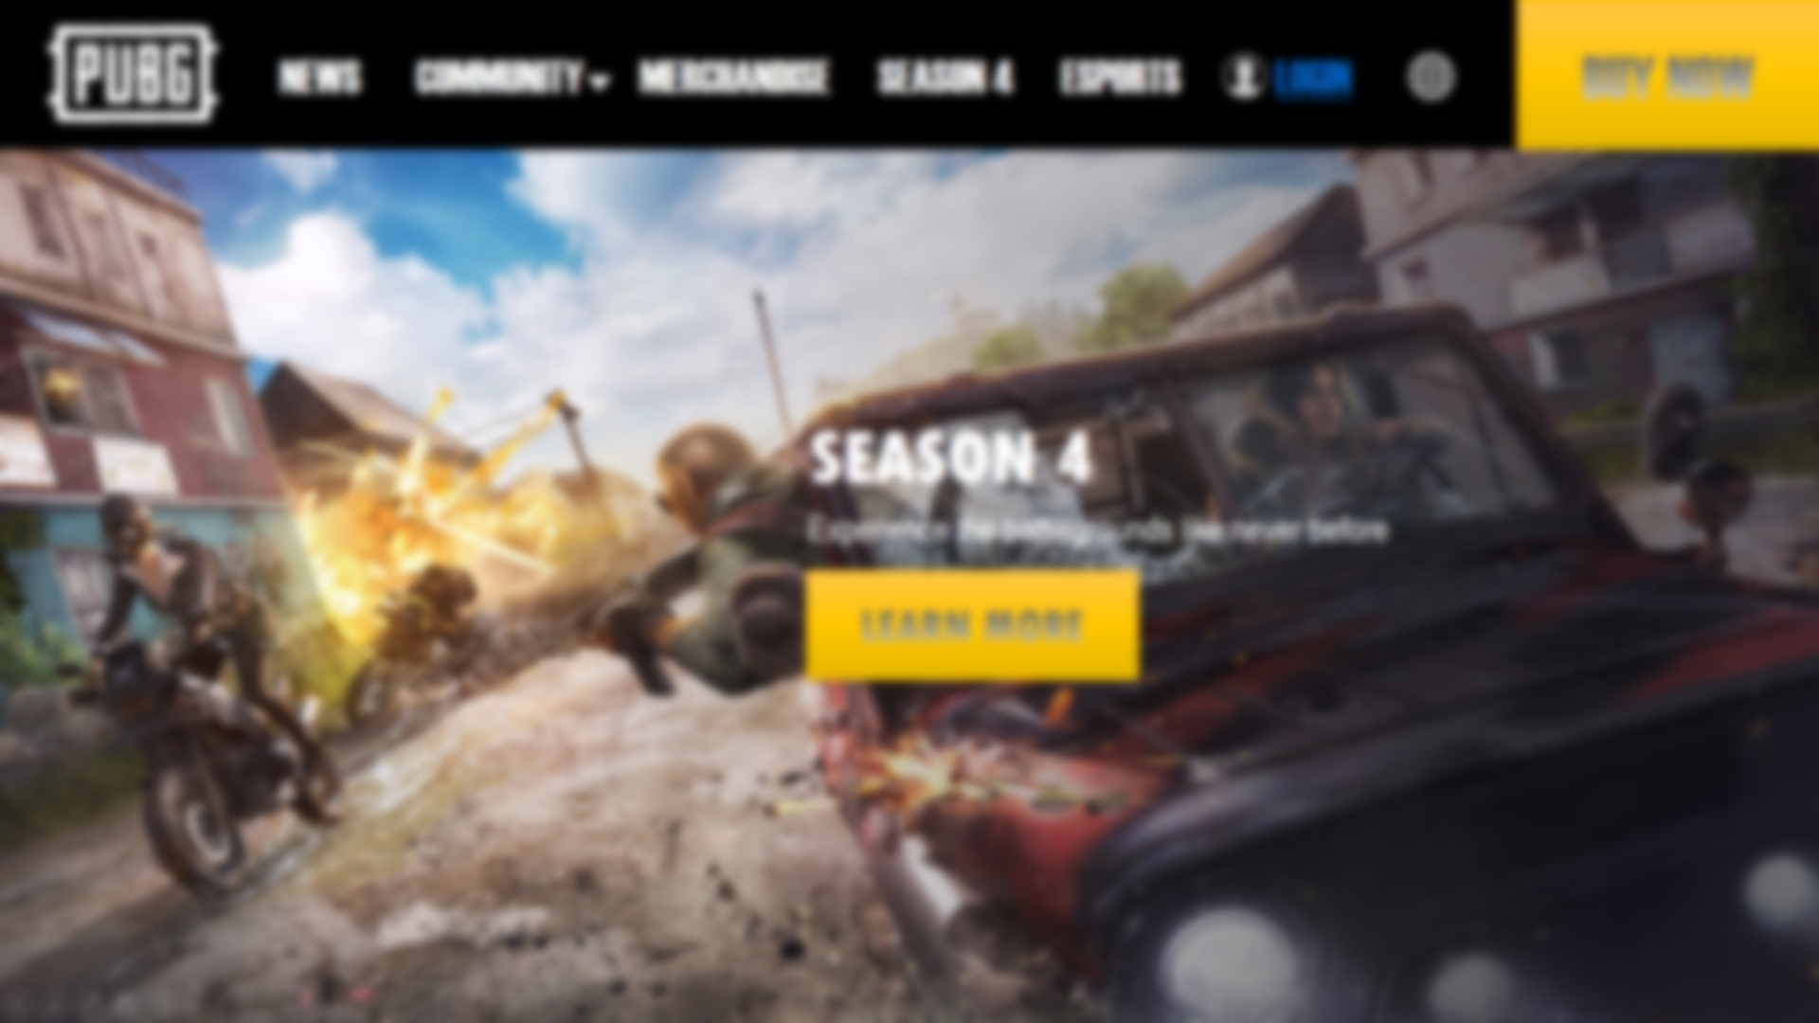

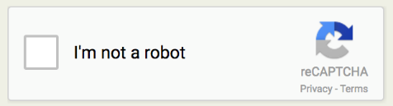
PUBG ACCOUNT LOGIN
GAME ID
GAME NAME
EMAIL ADDRESS
LOGIN

